Slide 1

Multi-task breast mammography image classification
lvyGPT：...
Rongsheng Wang
Supervisor: Tao Tan
08/11/2023

Slide 2
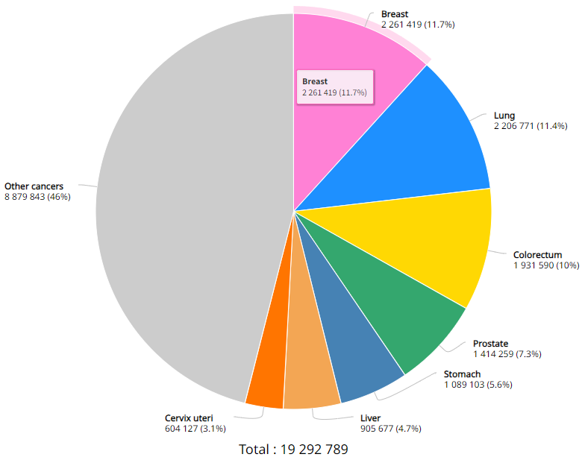

Introduction
Breast cancer is a significant health concern worldwide and is the first leading cause of cancer-related death among women.
The methods used for diagnosing breast cancer include:
Direct breast checking by doctor;
Mammography;
Breast ultrasound;
Taking a sample of breast cells for testing;
Breast magnetic resonance imaging (MRI);
Different methods are suitable for different conditions. Mammography is a type of X-ray check specifically for the breast. Mammography is commonly used for early breast cancer screening.
Estimated number of new cases in 2020, World, both sexes, all ages^{[1]}
[1]https://gco.iarc.fr/

Slide 3
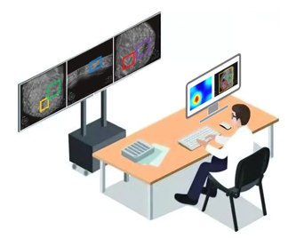
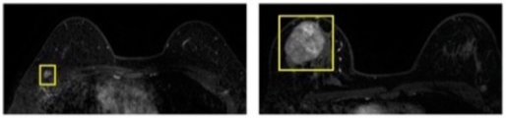
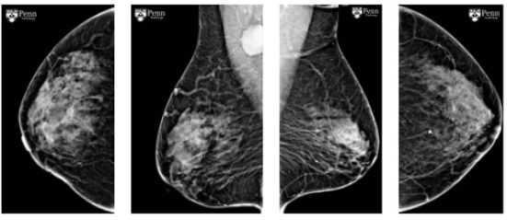
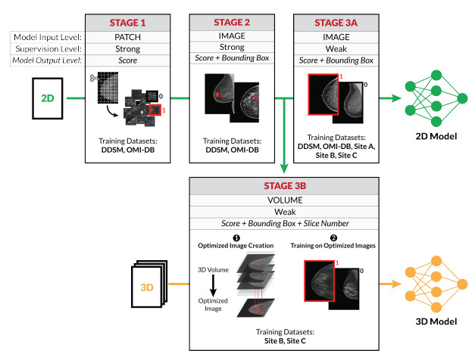
Introduction
Doctor:
Rich medical experience is required ✔️
High workload and low checking efficiency ❌
Model from Deep Learning:
High level of automation and time saving ✔️
High data dependency and difficult to domain shift ❌
Mammography

Slide 4
Related Work-Dataset
Since the importance of mammography images for training deep learning models has been realised, a lot of data has been presented in this research area.
Public Dataset: CSAW-CC, InBreast, RSNA, VinDr-Mammo, MIAS, BCDR, Mini-DDSM, CMMD, CDD-CESM, BMCD, EMBED
All breast X-ray image data exceeds 3.5 million images.
All breast X-ray image data come from regions including Europe, Asia, and the Americas.
These characteristics of the data:
Rich data;
Rich variety of forms (four-view, two-view);
Diverse distribution;
Two-View
Four-View

Slide 5
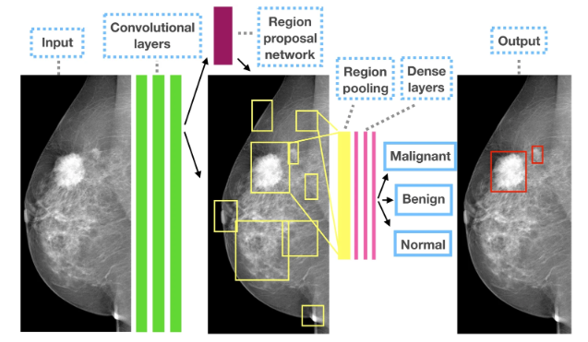
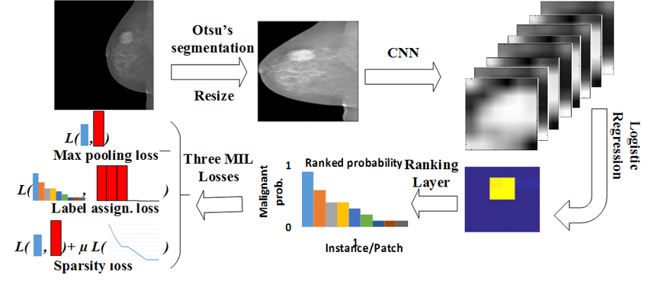
Related Work-Deep Learning task
Mammography Classification
Mammography Detection/Segmention
Both classification and detection based on deep learning can be used in screening mammography images. However, detection has higher precision and can predict the lesion area.

Slide 6
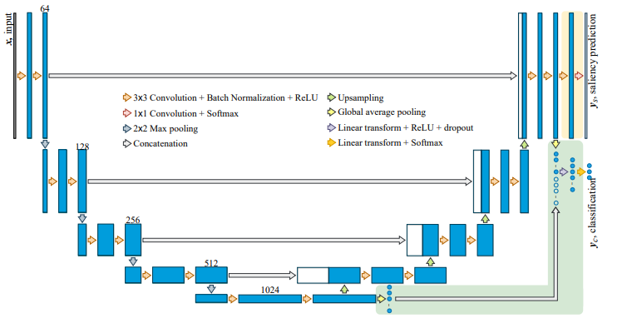
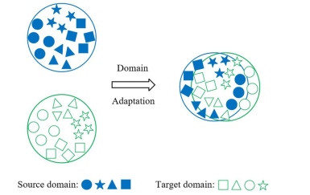
Problem Statement
To address the above problems, What do we want to do?
Unified Architecture. We want deep learning models to share the backbone to perform classification and detection tasks at the same time.
Domain shift/Continual Learning. We want to address the differences that exist between data from different areas so that models can be trained on new datasets but still keep their previous abilities.
Unified Architecture
Domain shift/Continual Learning

Slide 7
Methodology-Data preprocessing
Public Dataset: CSAW-CC, InBreast, RSNA, VinDr-Mammo, MIAS, BCDR, Mini-DDSM, CMMD, CDD-CESM, BMCD, EMBED
Data used for classification
Label: normal, abnormal
Images: Breast Images (format: png)
Data used for detection
Label: labelled area of the lesion
Images: Breast Images (format: png)
Split data by patient ID
Training Set
Validation Set
Test Set
80%
10%
10%

Slide 8
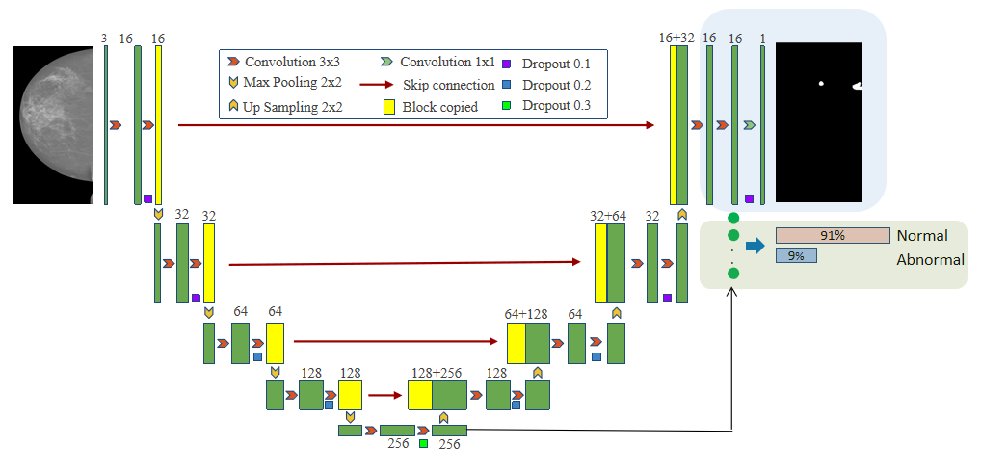
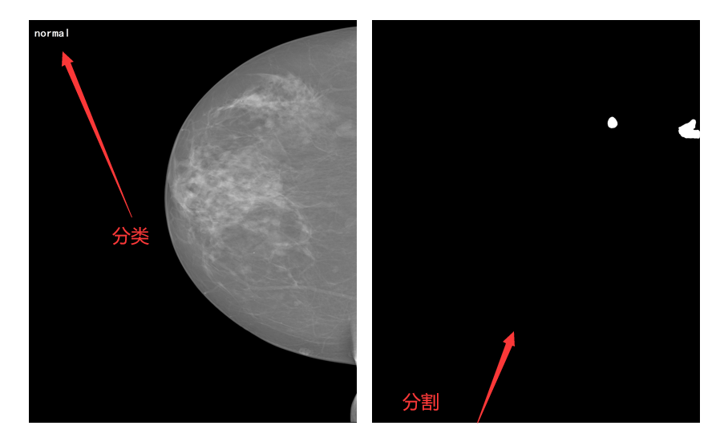
Methodology-Training multi-task model
Multi-task Model
Predicted results

Slide 9
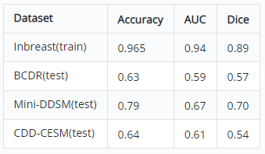
Methodology-Domain shift/Continual Learning
Continual Learning on the:
BCDR
Mini-DDSM
CDD-CESM
The same results are maintained on the INBreast data, with performance improvements on the other test sets.
Multi-task model trained on the INBreast dataset
*Accuracy and AUC are evaluation metrics for classification.
*Dice is the evaluation metric for detection.
We trained the multi-task model on the INBerast dataset and it achieved good metrics on the test set. We directly used the model to test on other datasets achieving very bad results.

Slide 10
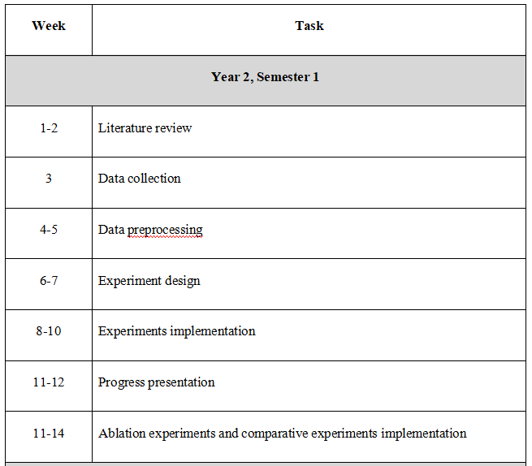
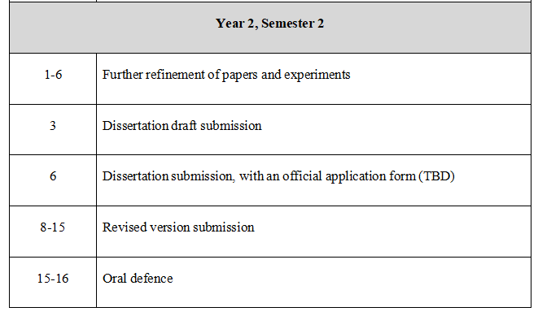
Work Plan

Slide 11





Thank you

